Slide 1

ANNAMACHARYA INSTITUTE OF TECHNOLOGY AND SCIENCES, RAJAMPET
(AN AUTONOMOUS INSTITUTION)
DEPARTMENT OF ARTIFICIAL INTELLIGENCE AND DATA SCIENCE
A Project Review on
DATA DETOX: A SMART AND VISUAL SYSTEM FOR ANOMALY DETECTION AND INTERACTIVE CLEANING
Under the Esteemed Guidance of
Mrs. N. Swathi, MTech
Assistant Professor
Department of Artificial Intelligence & Data Science
Rajampet, Andhra Pradesh
Presented by
H. KEERTHI (22701A3039)
K. DINESH REDDY (22701A3019)
A. MAHAMMAD SOHAIL (22701A3047)
A. KHADEERULLA (22701A3042)

Slide 2
CONTENTS
Title
Abstract
Existing System
Limitations of Existing System
Proposed System
Advantages of Proposed System
Software Requirements
Hardware Requirements

Slide 3
ABSTRACT
Data preprocessing is one of the most time-intensive and critical stages in the data science pipeline, accounting for nearly 70–80% of the total effort in most analytics and machine learning projects. Traditional manual approaches to cleaning data are not only tedious and repetitive but also prone to human error, especially when handling large and complex datasets.
This project presents the Automated Data Cleaning Streamlit App (Data Detox) — a web-based solution designed to automate the most common preprocessing tasks. The system provides users with a simple, interactive interface where they can upload datasets and perform:
Missing value handling (drop, impute with statistical methods)
Duplicate removal
Outlier detection
AI-powered anomaly detection
Automated visualization of data quality issues
Additionally, the system generates a before-and-after cleaning report, enabling transparency, reproducibility, and better decision-making for downstream analytics. By integrating automation with AI, the proposed system helps students, researchers, and professionals save time, improve efficiency, and ensure higher-quality datasets for analytics and machine learning.

Slide 4
Existing System
Currently, data preprocessing — which includes handling missing values, duplicates, outliers, and anomalies — is typically performed through the following methods:
Manual Techniques
  Users rely on Excel operations such as filtering, sorting, conditional formatting, and pivot tables to identify and correct data quality issues.
  Programmers use custom Python or R scripts with libraries like pandas, dplyr, or tidyr to handle missing data, outliers, and inconsistent formats.
Third-Party Tools
  Software tools such as OpenRefine and specialized Excel add-ins offer some degree of automation for cleaning tasks.
  Proprietary enterprise-level platforms (e.g., SAS, Trifacta, Talend) provide more features but often require licensing fees, making them inaccessible for students and small-scale users.
Hybrid Approaches
  Many organizations combine manual Excel-based methods with partial automation using scripts, resulting in fragmented workflows that are not integrated.
Drawbacks of the Existing System:
Require technical expertise to write, modify, and debug scripts.
Lack automation for repetitive tasks, leading to wasted time when handling multiple datasets.
Fail to provide a unified solution with anomaly detection, visualization, and reporting in one platform.
Not suitable for non-programmers or users without advanced data science knowledge.
Existing tools often address only specific problems (like missing values) rather than offering an end-to-end solution.

Slide 5
Limitations of Existing System
Despite the availability of manual techniques and third-party tools, current approaches suffer from several major limitations:
Time-Consuming
  Every dataset requires repetitive manual cleaning operations.
  For large datasets, preprocessing can take hours or even days, delaying analysis and decision-making.
Error-Prone
  Manual cleaning is highly vulnerable to human mistakes, such as incorrect formula application, misclassification of values, or incomplete removal of duplicates.
  Small errors can propagate and compromise the accuracy of downstream analytics and machine learning models.
Limited Outlier/Anomaly Detection
  Most tools rely on basic descriptive statistics (mean, median, standard deviation) and lack advanced anomaly detection techniques (e.g., Isolation Forest, clustering-based methods).
  This results in undetected irregularities that may bias the results.
Lack of Integrated Visualization
  Current systems rarely provide real-time, interactive visualizations (heatmaps, correlation plots, boxplots) that help users understand the scope of data issues.
  Users often have to switch to separate visualization tools, causing inefficiency.
No Automated Reporting
  Existing tools do not generate structured reports of the cleaning process.
  This reduces reproducibility and makes it difficult for teams or researchers to track what transformations were applied to the dataset.

Slide 6
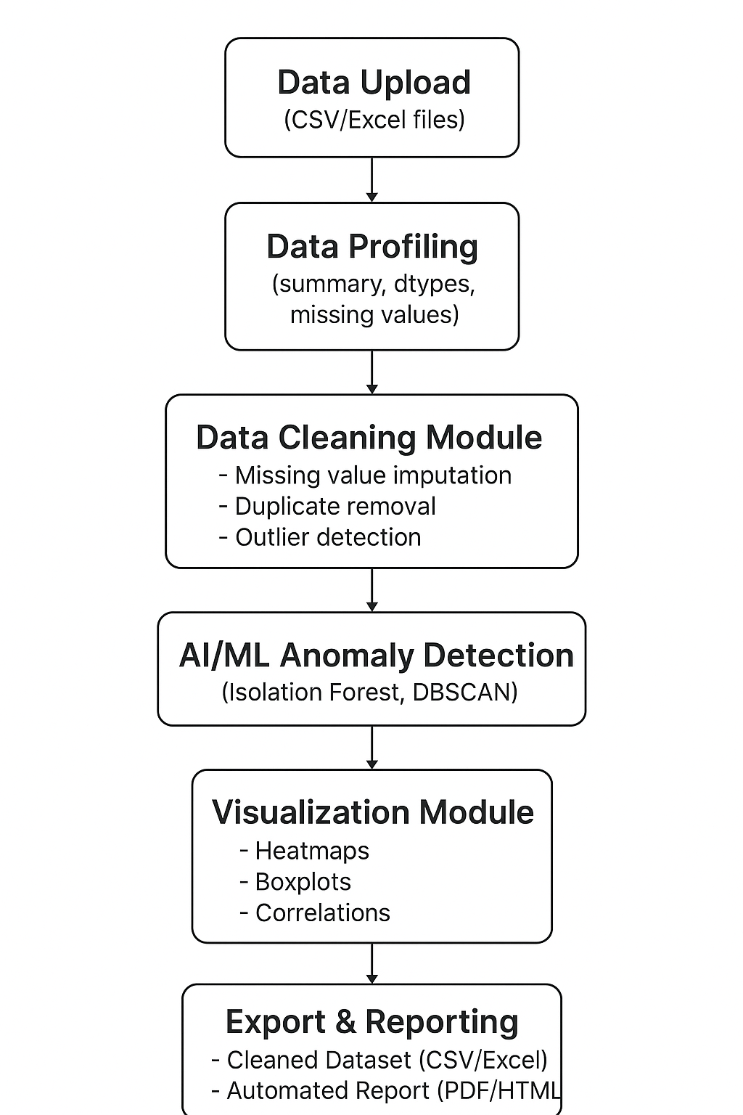
Proposed System
The Data Detox App is designed as an end-to-end interactive data preprocessing solution that simplifies dataset cleaning and ensures high-quality data for analytics and machine learning.
Data Upload & Profiling: Upload raw datasets to instantly view structure, datatypes, missing values, and duplicates.
Automated Data Cleaning: Automatically clean data by imputing or dropping missing values, removing duplicates, and detecting outliers.
AI-Powered Anomaly Detection: Identify unusual patterns in data using advanced ML models like Isolation Forest and DBSCAN.
Visualization Module: Gain insights with interactive charts including heatmaps, boxplots, and correlation plots.
Export & Reporting : Download cleaned datasets and generate comprehensive reports in CSV, Excel, PDF, or HTML.

Slide 7
Advantages of Proposed System
Time-efficient: Automates repetitive data cleaning steps.
User-friendly: Requires no prior coding knowledge.
AI-driven: Anomaly detection improves dataset quality.
Visualization support: Enhances user understanding of data issues.
Reusable: Can be applied to datasets from diverse fields like healthcare, finance, research, etc.
Comprehensive documentation: Generates before-and-after reports for reproducibility.

Slide 8
Software Requirements
Operating System: Windows, Linux, or MacOS
Programming Language: Python 3.10 or above
Libraries:
  Core: pandas, numpy, scikit-learn, streamlit
  Visualization: matplotlib, seaborn, plotly
  Optional Enhancements: ydata-profiling, imbalanced-learn
Development Tools: Jupyter Notebook, Visual Studio Code, or PyCharm

Slide 9
Hardware Requirements
Minimum Requirements:
  RAM: 4 GB
  Processor: Dual-core (Intel/AMD equivalent)
  Storage: 500 MB free disk space
  Internet connection (for deployment and external datasets)
Recommended Requirements:
  RAM: 8 GB or more
  Processor: Quad-core
  Storage: 1 GB or more
  Stable internet for real-time deployment and cloud hosting

